Slide 1

WQF7007 Natural Language Processing (OCC2)
Text-Based Mental Health Disorder Classification Using Natural Language Processing
SDG3 Good Health and Well-Being
Presentation By
Group 14
Name | Matric No
Yap Hui Qing | 24080940
Yeoh Li Ting | 23079401
Yap Jiun Soong | 24070916
Lim Chin Pei | 24077115
Ang Anson | 17203192
Liew Jia Yi | 25075973
LECTURER: DR. MOHAMED N. M. LUBANI

Slide 2
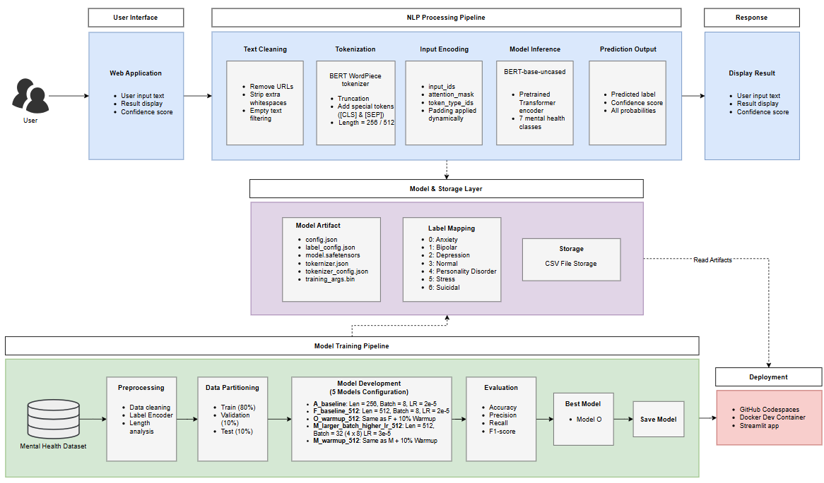
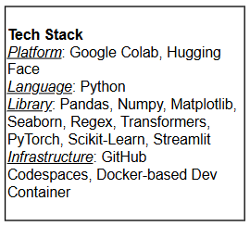
WQF7007 Natural Language Processing (OCC2)
ARCHITECTURE OF THE NLP SYSTEM

Slide 3
WQF7007 Natural Language Processing (OCC2)
DATASET
Dataset
Source
Data Size
Mental Health Condition Classification
Hugging Face
Link: mental_health dataset
Row: 103,488
Column: 2
7 Classes
Anxiety, Normal, Depression, Stress, Personality Disorder, Bipolar and Suicidal
Attribute
Target Feature
Duplicate &
Missing Value
Text
Status (7 Classes)
None

Slide 4
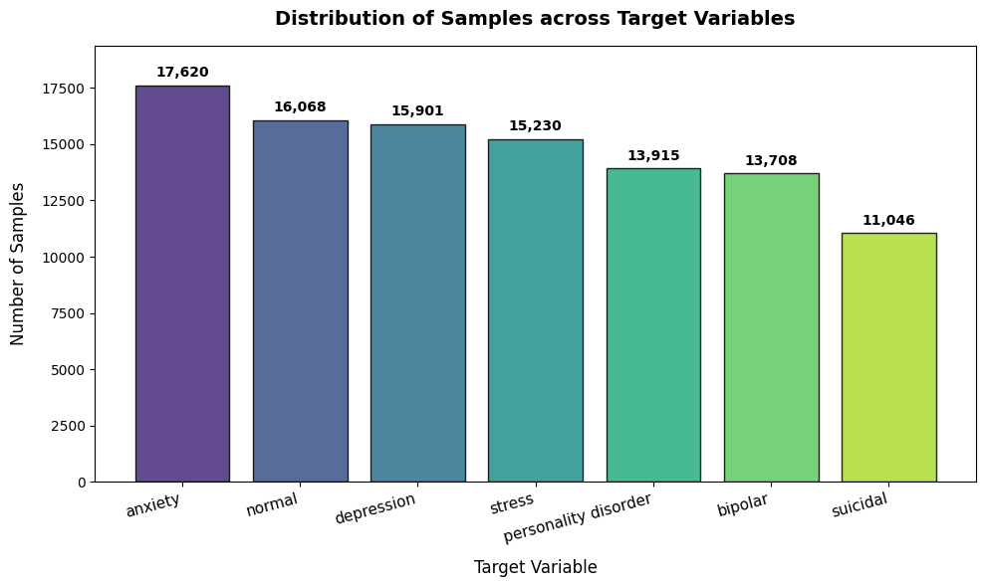
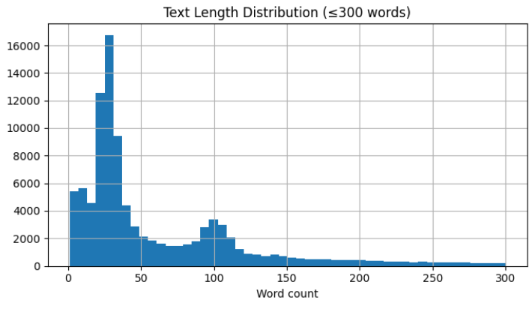
WQF7007 Natural Language Processing (OCC2)
EXPLORATORY DATA ANALYSIS
Class Distribution
Text Length Analysis
Class imbalance is not severe.
Solution: stratified data splitting & weighted evaluation metrics used
Number of rows: 103,488
Mean: 82.02 words
Median: 34 words
25th percentile: 24 words
75th percentile: 99 words
Maximum: 5,419 words
More than 128 words: 16,367 (15.82%)
More than 256 words: 6,600 (6.38%)
More than 512 words: 1,614 (1.56%)

Slide 5
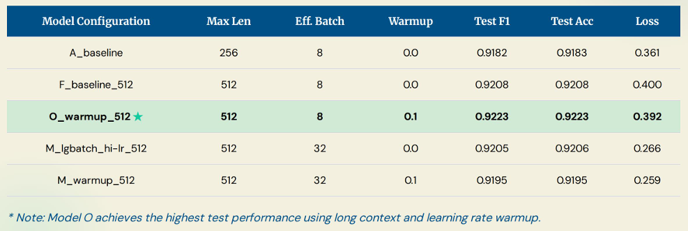
WQF7007 Natural Language Processing (OCC2)
EXPERIMENTAL FINDINGS & EVALUATION
Prioritize F1-Score
Plain accuracy is misleading when class sizes range significantly (Anxiety: 17K VS Suicidal: 11K)
Penalizes models that sacrifice either precision or recall
Missing a suicidal post (false negative) is far more critical than a false alarm

Slide 6
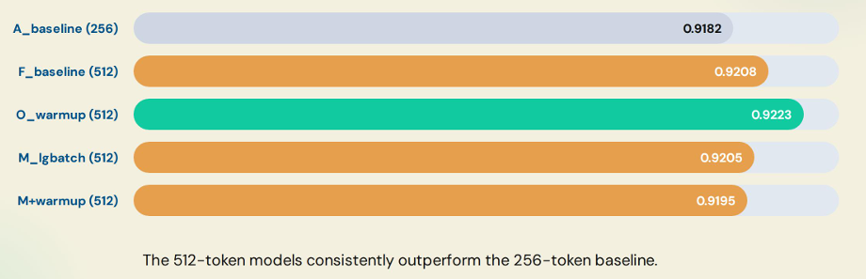
WQF7007 Natural Language Processing (OCC2)
EXPERIMENTAL FINDINGS & EVALUATION
Test F1 Performance by Models
No single model consistently outperformed others across all metrics.
However, Model O achieved the best balance of validation and test performance, particularly in test F1-score, and was selected as the final model.

Slide 7
WQF7007 Natural Language Processing (OCC2)
EXPERIMENTAL FINDINGS & EVALUATION
Impact of Maximum Sequence Length
Key Result
Model A (256 tokens): Test F1 = 0.9182
Model F (512 tokens): Test F1 = 0.9208
Improvement: +0.0026 F1
Reduced Text Truncation
256 tokens: 8.2% of training texts truncated
512 tokens: 2.3% of training texts truncated
Longer inputs preserve more contextual and discriminative information
Model | depression F1 | suicidal F1
A_baseline | 0.798 | 0.755
F_baseline_512 | 0.805 | 0.767
O_warmup_512 | 0.809 | 0.770
M_lgbatch_hi-lr_512 | 0.809 | 0.769
M_warmup_512 | 0.805 | 0.761
Largest gains observed in Depression and Suicidal categories
The posts are typically longer and more narrative-based
Longer sequence length capture important context that would otherwise be truncated
The trade-off is training time increase from ~ 54 mins to ~72 mins

Slide 8
WQF7007 Natural Language Processing (OCC2)
EXPERIMENTAL FINDINGS & EVALUATION
Impact of Warm up (0.1)
Key Result
Model F (512 tokens): Test F1 = 0.9208
Model O (512 tokens): Test F1 = 0.9223
Improvement: +0.0015 F1
Warm Up (0.1)
Warmup linearly ramps the learning rate from zero up to its target (2e-5) over the first 10% of training steps before the usual decay begins
By stabilizing early updates so the freshly-initialized classifier head does not make large destructive changes to the pretrained weights before the learning rate settles.
However, this is a marginal and noisy effect and it only helped the small-batch configuration: adding warmup to the large-batch M actually lowered test F1 (0.9205 → 0.9195).
Model | Batch Size | Warm Up | F1
F_baseline_512 | 8 | 0 | 0.9208
O_warmup_512 | 8 | 0.1 | 0.9223
M_warmup_512 | 32 | 0 | 0.9206
M_warmup_512 | 32 | 0.1 | 0.9195

Slide 9
WQF7007 Natural Language Processing (OCC2)
EXPERIMENTAL FINDINGS & EVALUATION
Effect of Large Batch Size and Higher Learning Rate
Key Findings
Increase effective batch size from 8 to 32 (using gradient accumulation)
Increased learning rate from 2e-5 to 3e-5
Based on the model F, M and M+Warmup, there is no significant improvement in F1-score
Benefits
Lower test loss:
M: 0.266
M+Warmup: 0.259
Baseline: ~0.39 - 0.40
Better probability calibration
More efficient training
7,764 optimizer steps vs 31,047 steps
Parameters Impact on F1
Sequence length - most effective improvement
Warmup - small and inconsistent improvement
Larger batch and higher learning rate - improves efficiency, not accuracy

Slide 10
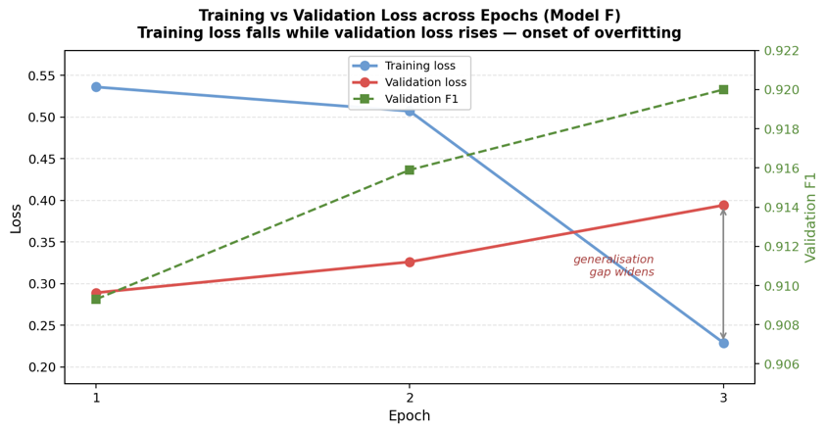
WQF7007 Natural Language Processing (OCC2)
EXPERIMENTAL FINDINGS & EVALUATION
Effect of Training for more Epochs
Increasing training from 3 to 5 epochs did not improve performance
Validation loss increased while training loss decreased, indicating overfitting
The model begins to memorize training data rather than generalize
3 epochs is the optimal training point
Example (Model F):
training loss 0.536 → 0.229, validation loss 0.289 → 0.394

Slide 11
WQF7007 Natural Language Processing (OCC2)
CONCLUSION
LIMITATIONS
FUTURE WORK
Computational cost
Class performance gap
Only BERT-based model
Single modality data - limited to text only
Optimize computational efficiency
Target the depression–suicidal bottleneck
Stronger and domain-specific models (MentalBERT / ClinicalBERT)
Explore multimodal mental health
Overall, the results show that increasing the maximum sequence length to 512 tokens and applying a warmup ratio of 0.1 provided the most consistent improvements. In contrast, increasing the effective batch size, learning rate, and number of training epochs did not improve performance. Therefore, Model O was selected as the final model as it achieved the best overall performance, with a Test Accuracy of 0.9223 and a Test F1-score of 0.9223.

Slide 12
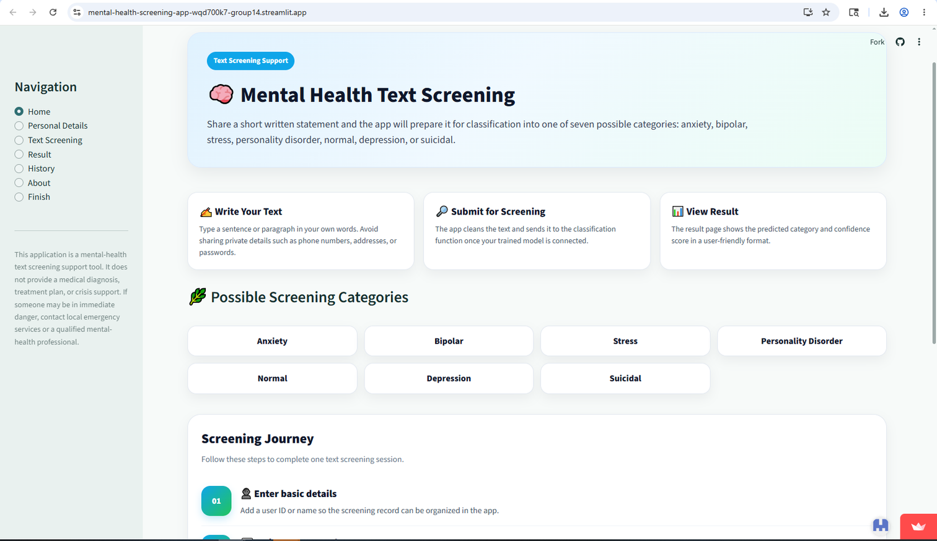
WQF7007 Natural Language Processing (OCC2)
MENTAL HEALTH TEXT SCREENING (DEMO)
Link to access: https://mental-health-screening-app-wqd700k7-group14.streamlit.app/
Steps:
1
write text
2
Submit
3
View Result

Slide 13
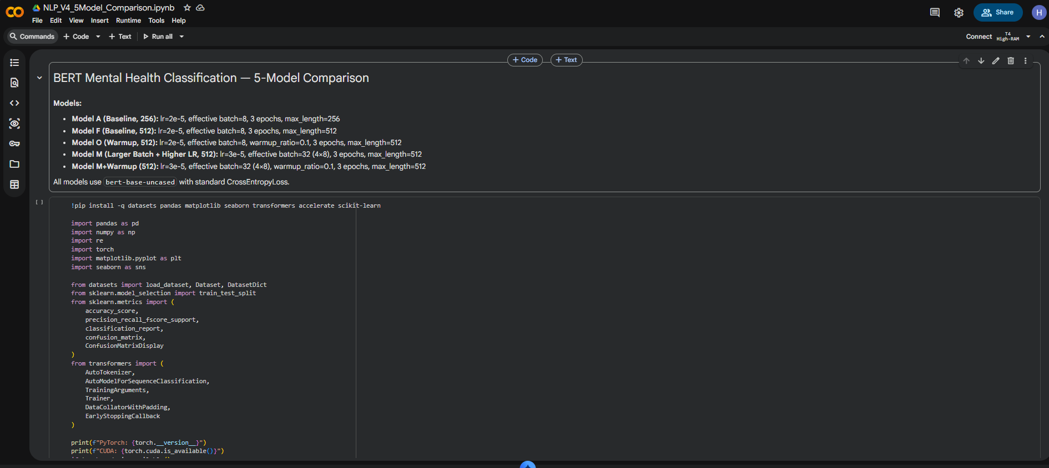
WQF7007 Natural Language Processing (OCC2)
APPENDIX A: MODEL TRAINING CODE
Link to access: https://drive.google.com/drive/folders/1WYvISmRBFh2YG06ORExWuZ1UoQYXY27O?usp=drive_link

Slide 14
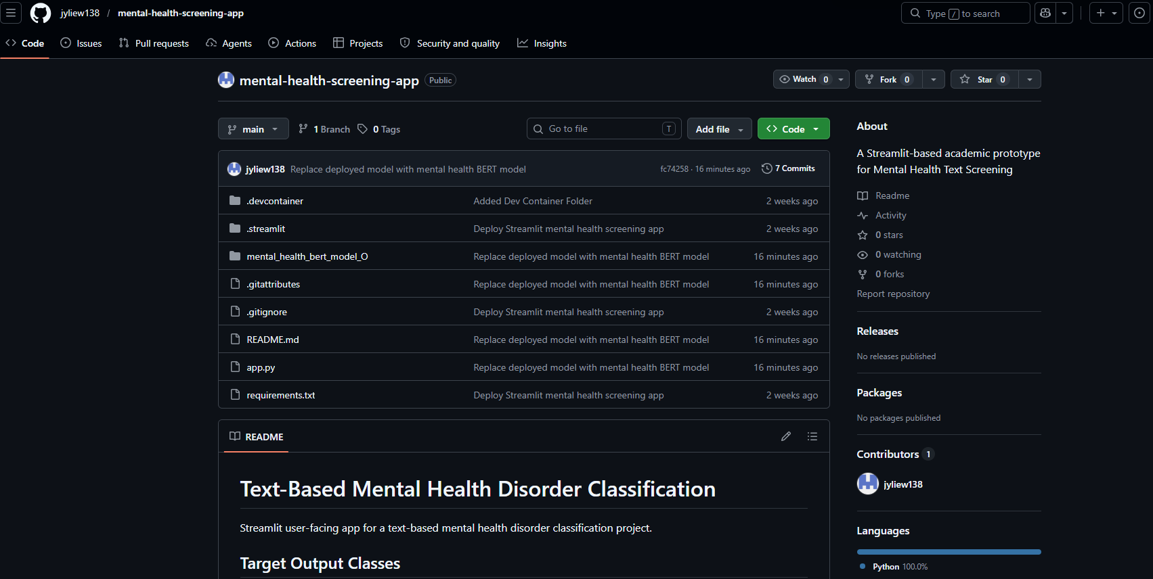
WQF7007 Natural Language Processing (OCC2)
APPENDIX B: DEPLOYEMENT CODE
Link to access: https://github.com/jyliew138/mental-health-screening-app

Slide 15
Thank You
Take Care of Your Mind
Start today by taking small steps toward a healthier and happier life

